Slide 1
TRAINING SESSIONS FOR ALL REGIONS ACROSS PAKISTAN HELD ON GENDER SENSITIVITY VIA ZOOM

Slide 2
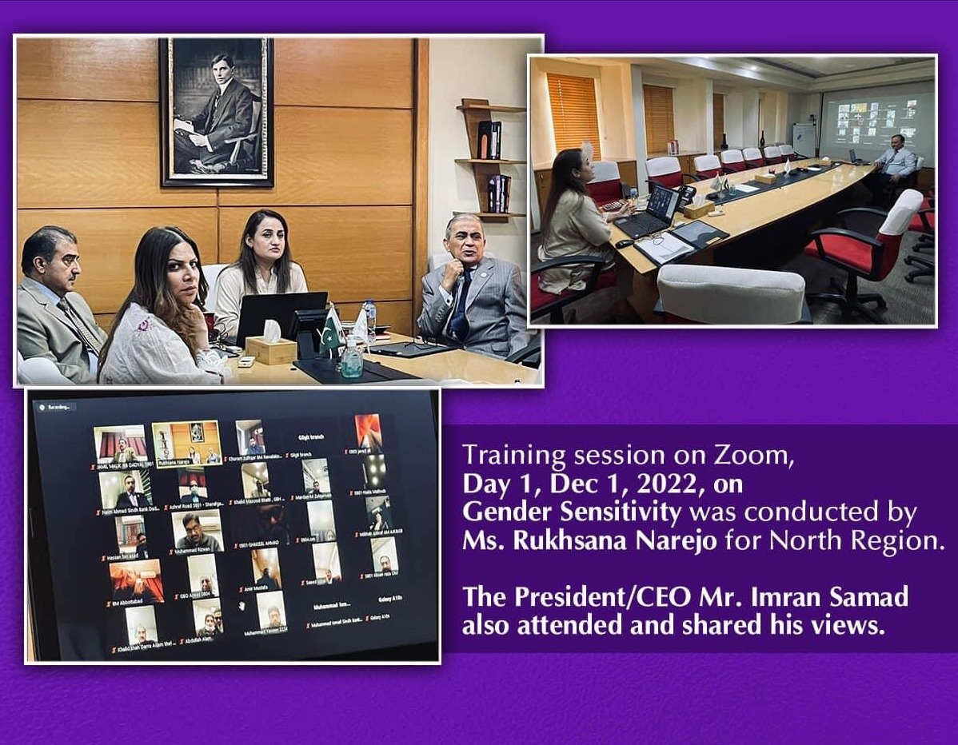
TRAINING DAY 1
Date : December 01, 2022
Region : North
No of Participants : 47

Slide 3
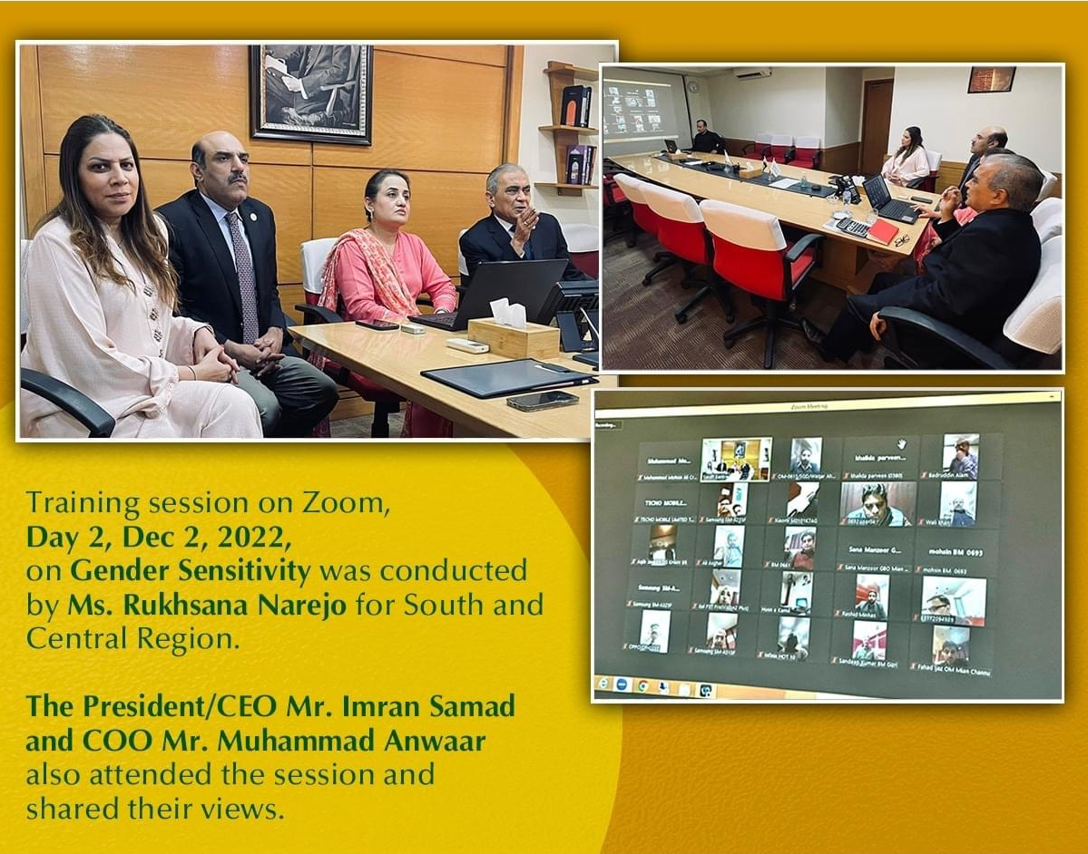
TRAINING DAY 2
Date : December 02, 2022
Region : South & Central
No of Participants :
South Region : 185
Central Region: 107

Slide 4
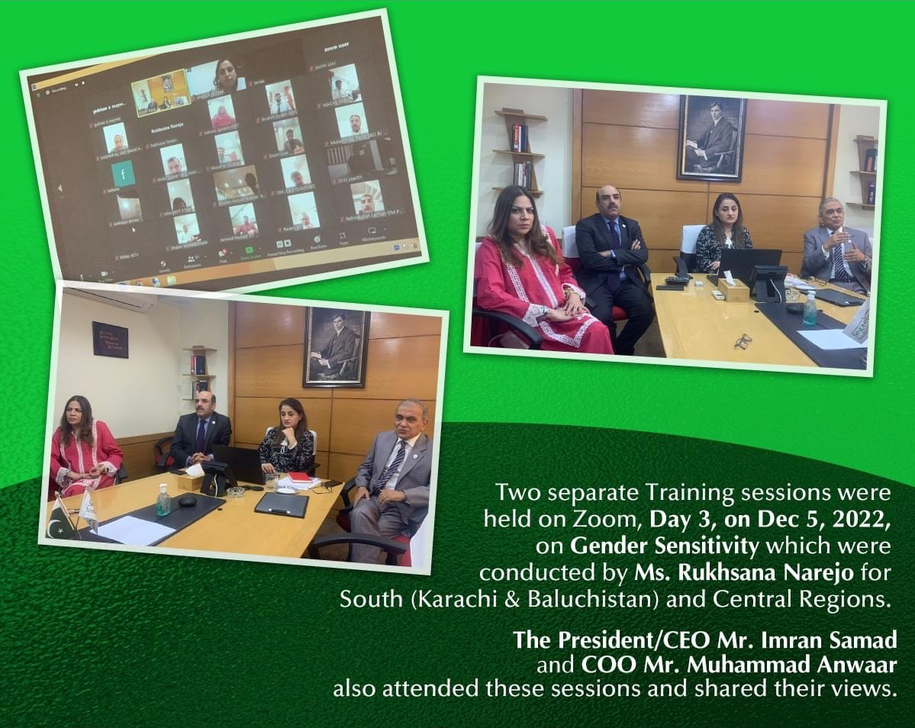
TRAINING DAY 3
Date : December 05, 2022
Region : Central & South (Karachi & Baluchistan )
No of Participants :
South Region : 95
Central Region : 100

Slide 5
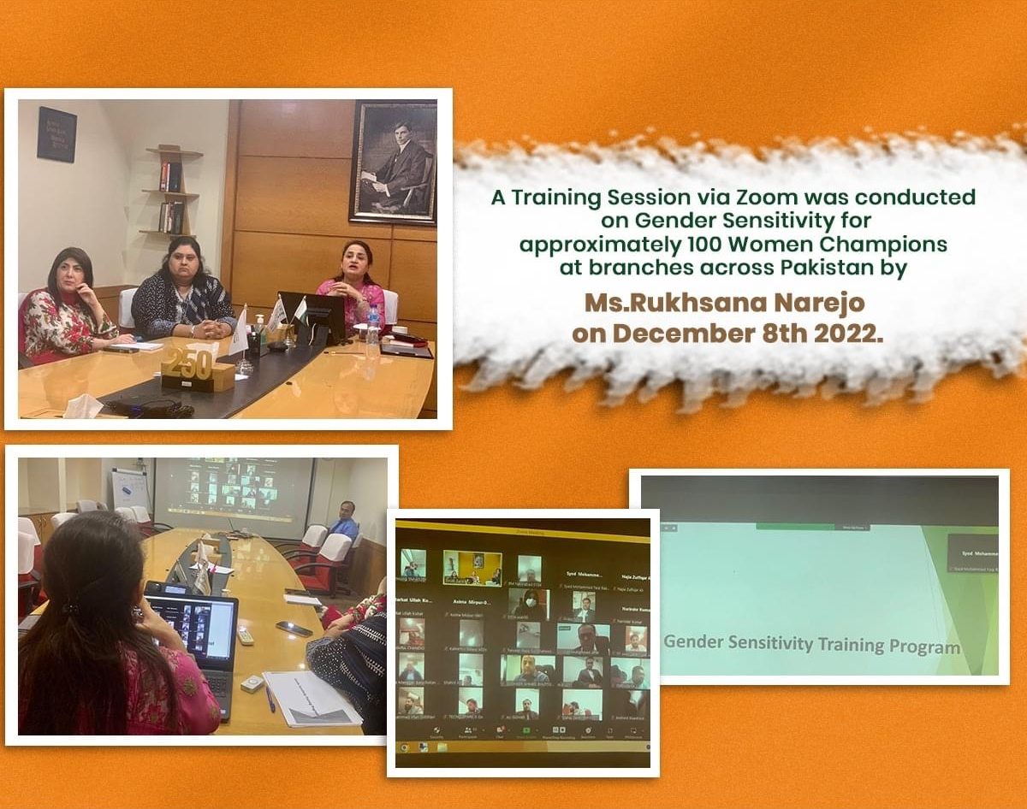
TRAINING DAY 4
Date : December 08, 2022
Region : Across Pakistan
No of Participants : 100

Slide 6
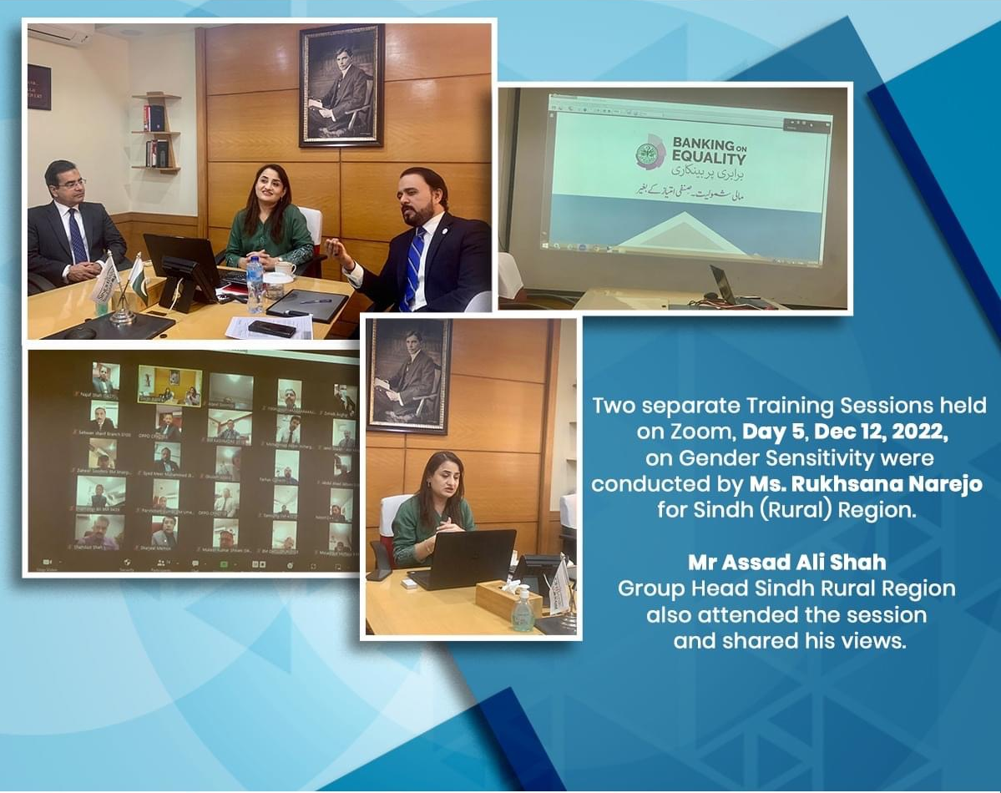
TRAINING DAY 5
Date : December 12, 2022
Region : Sindh Rural Region
No of Participants :
First Session : 93
Second Session : 85

Slide 7
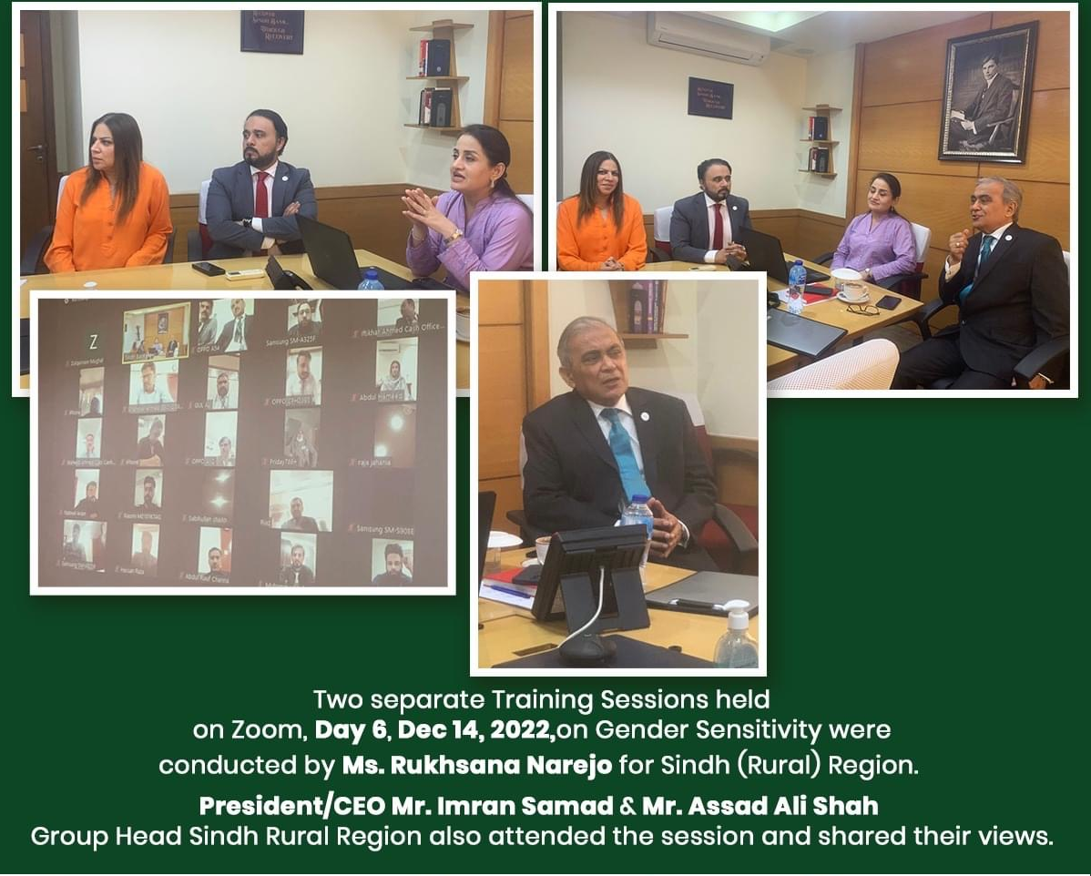
TRAINING DAY 6
Date : December 14 ,2022
Region : Sindh Rural Region
No of Participants : 116

Slide 8
THANK YOU

