Slide 1
TRAINING SESSIONS HELD ON GENDER SENSITIVITY
August 29 – August 30, 2025
Training sessions were conducted at Sindh Bank Training Center, Lahore on Gender Sensitivity by the Facilitator, Mr. Sohail Muhammed Ali from TAO of Leadership. He conducted 4 sessions starting from August 29, 2025 till August 30, 2025 and appx 175 employees were trained from the Lahore Branches.

Slide 2
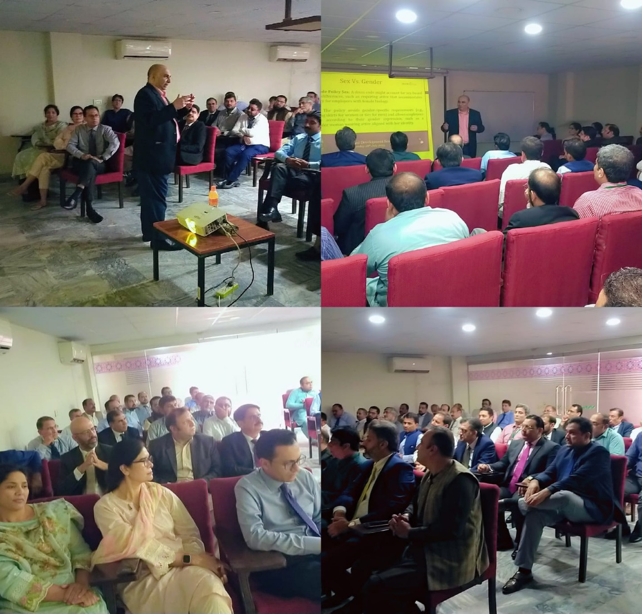
TRAINING DAY 1 – SESSION 1
Date : August 29, 2025
No of Participants : 52

Slide 3
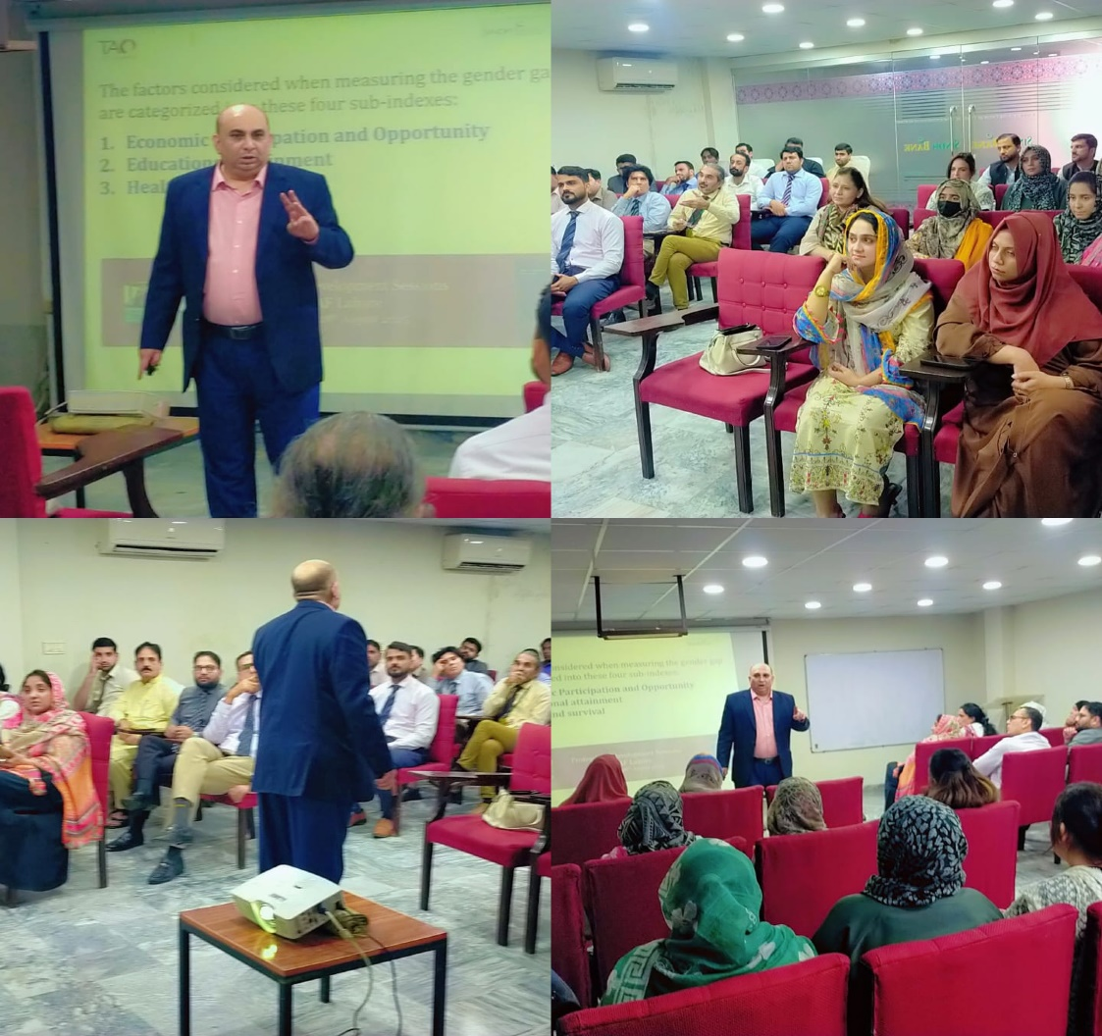
TRAINING DAY 1 – SESSION 2
Date : August 29, 2025
No of Participants : 50

Slide 4
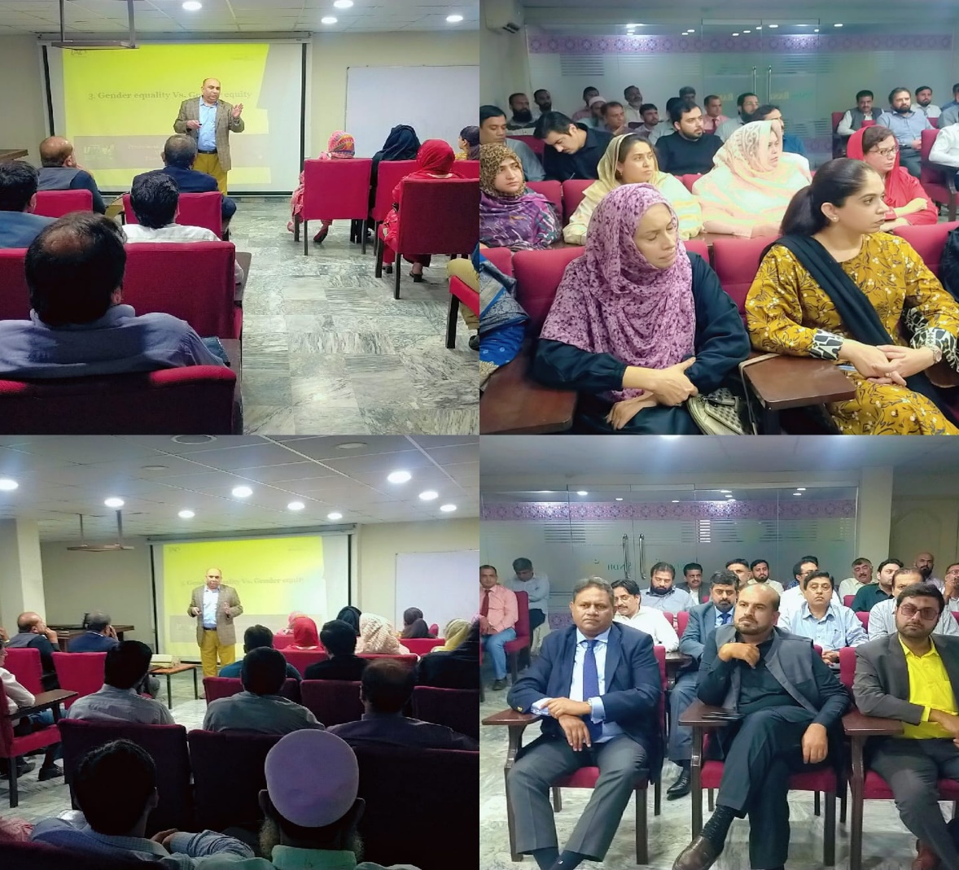
TRAINING DAY 2 – SESSION 1
Date : August 30, 2025
No of Participants : 44

Slide 5
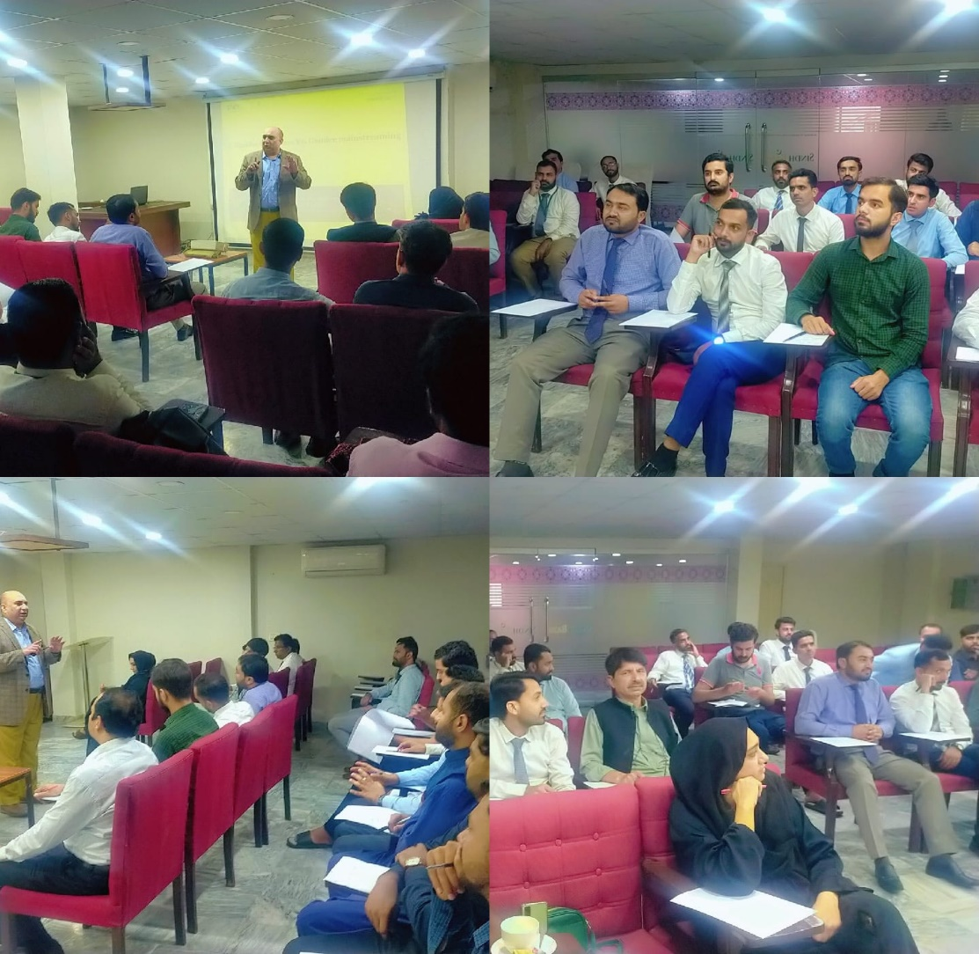
TRAINING DAY 2 – SESSION 2
Date : August 30, 2025
No of Participants : 29

